Slide 1
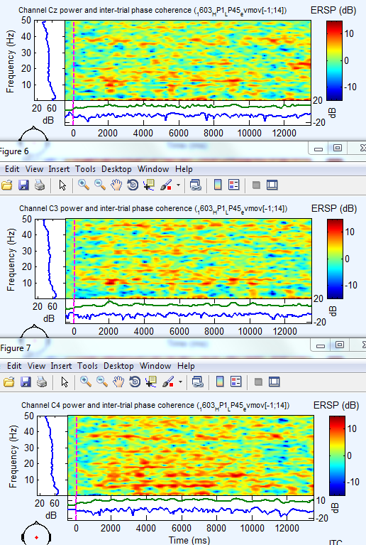
ERSP on Cz, C3 & C4 of 20101013_1608_HP1_LP45_evmov[-1;14]
At 0 sec : auditive top to start foot movement (averaging on 3 trials)
At 10 sec : auditive top to stop foot movement (averaging on 3 trials)
ERSP arg : winsize=2048 | erspmax=15 | padding=4
It is difficult to identify a significative increase of a specific band.

Slide 2
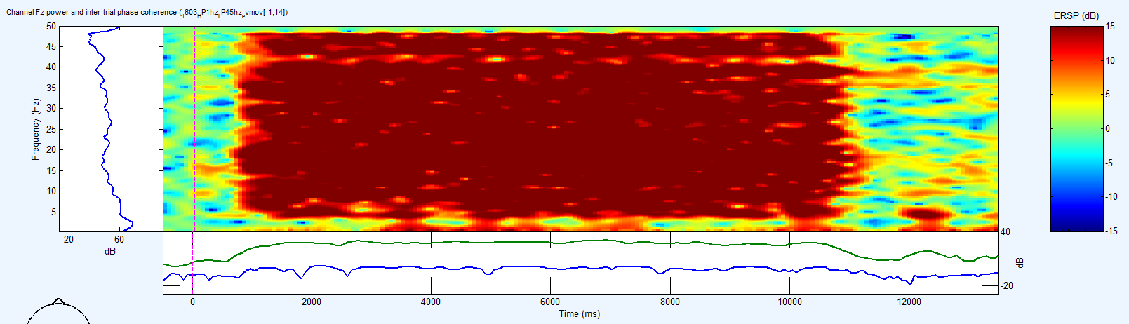
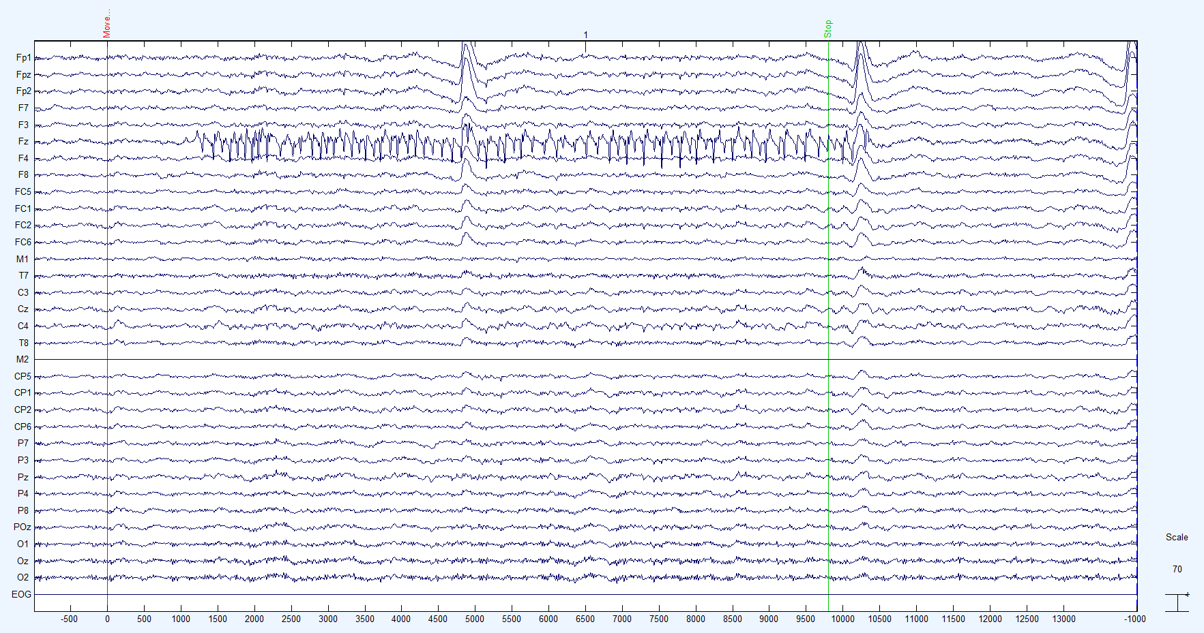
ERSP on Fz of 20101013_1608_HP1_LP45_evmov[-1;14]
At 0 sec : auditive top to start foot movement (averaging on 3 trials)
At 10 sec : auditive top to stop foot movement (averaging on 3 trials)
ERSP arg : winsize=2048 | erspmax=15 | padding=4
THIS IS NOT PHYSIOLOGICAL !!!
(problem on Fz)
It is realy easy to identify a significative increase in this bad electrode.

